Slide 1
Rhone: Quality-Based Query Rewriting Algorithm for Data Integration
Daniel Aguiar da Silva Carvalho, Magellan, IAE, Univ. J. Moulin Lyon 3, France
Plácido Antonio de Souza Neto, DIATINF, IFRN, Brazil
Chirine Ghedira-Guegan, Magellan, IAE, Univ. J. Moulin Lyon 3, France
Nadia Bennani, LIRIS-CNRS, INSA-Lyon, Univ. Lyon, France
Genoveva Vargas-Solar, CRNS, LIG-LAFMIA, France
Notes:
Good morning, I am Sebastien Dufromentel from INSA Lyon in France and today I am presenting on behalf of my colleagues that could not make it to the conference. The work is motivated and oriented to answer a research question:
Can Data integration quality be enchanced on multicloud using SLA?
Let’s see how they tried to answer this question.

Slide 2
Agenda
Data integration from services: motivation and objective
Rhone Service-Based Query Rewriting Algorithm
Principle & example
Experimental validation
Lessons learned and future work
Notes:
The agenda of my presentation... I will begin by introducing our work regarding data integration quality on multi-cloud environments
then i will present the method we followed to identify challenges and open issues
then a quantitative analysis and conclusion...

Slide 3
Data integration: existing work
Data integration: the teenage years. Halevy, A., Rajaraman, A., & Ordille, J. (VLDB 2006, September)
Result
Query
Global
schema
Query rewriting
Mediator
Schema integration: Past, present, and future (Ram, S., & Ramesh, V. 1999)
MiniCon algorithm for query rewriting (Pottinger and Halevy, 2001)
Pivot data model & query language
(GaV, LaV, ontologies)
Exported schemata
Data integration architectures:
Multi-databases, federations, DW, …
(Domenig & Dittrich 1999 Sigmod Record]
Data
source A
Data
source B
Data
source C
Heterogeneous data sources modelled
& known in advance
Notes:
We are manly interested in the data integration problem which consists in merging data from different sources and provide to the user a unified view of these data
Let me show you the classical data integration scenario, ... we have different data sources (A, B and C), and a query that must be answered. This query is submitted to a mediator which is responsible for rewriting it in accordance with the different databases. Then the results are returned to the mediator which will be responsible for integrating the data and sending back the integrated result.
As I mentioned before this is the classical data integration scenario... however the emergency of architectures like cloud open new opportunities for data integration considering that now we are not limited to resources availability .

Slide 4
Data integration: existing work
Result
Query
Mediator
Exported API
. . .
Distributed data services
Notes:
We are manly interested in the data integration problem which consists in merging data from different sources and provide to the user a unified view of these data
Let me show you the classical data integration scenario, ... we have different data sources (A, B and C), and a query that must be answered. This query is submitted to a mediator which is responsible for rewriting it in accordance with the different databases. Then the results are returned to the mediator which will be responsible for integrating the data and sending back the integrated result.
As I mentioned before this is the classical data integration scenario... however the emergency of architectures like cloud open new opportunities for data integration considering that now we are not limited to resources availability .

Slide 5
Data integration: existing work
Services lookup and matching
[1] Paolucci, M., Kawamura, T., Payne, T. R., & Sycara, K. (2002, June). Semantic matching of web services capabilities. In International Semantic Web Conference (pp. 333-347). Springer Berlin Heidelberg.
[2} Bramantoro, A., Krishnaswamy, S., & Indrawan, M. (2005, November). A semantic distance measure for matching web services. In International Conference on Web Information Systems Engineering (pp. 217-226). Springer Berlin Heidelberg.
[3} APA Maximilien, E. M., & Singh, M. P. (2004, November). Toward autonomic web services trust and selection. In Proceedings of the 2nd international conference on Service oriented computing (pp. 212-221). ACM.
Q
Query rewriting techniques
adapted to service composition
[2] Barhamgi, M., Benslimane, D., and Medjahed, B. (2010). A query rewriting approach for web service composition. IEEE T. Services Computing, 3(3):206–222.
[3] da Costa, U. S., Alves, M. H. F., Musicante, M. A., and Robert, S. (2013). Automatic refinement of service compositions. In Daniel, F., Dolog, P., and Li, Q., editors, ICWE, volume 7977 of Lecture Notes in Com- puter Science, pages 400–407. Springer.
[4] Zhao, W., Liu, C., and Chen, J. (2011). Automatic compo- sition of information-providing web services based on query rewriting. Science China Information Sciences, pages 1–17.
. . .
Notes:
We are manly interested in the data integration problem which consists in merging data from different sources and provide to the user a unified view of these data
Let me show you the classical data integration scenario, ... we have different data sources (A, B and C), and a query that must be answered. This query is submitted to a mediator which is responsible for rewriting it in accordance with the different databases. Then the results are returned to the mediator which will be responsible for integrating the data and sending back the integrated result.
As I mentioned before this is the classical data integration scenario... however the emergency of architectures like cloud open new opportunities for data integration considering that now we are not limited to resources availability .

Slide 6



Data integration from data services
SLA
SLA
Availabity > 99,9%
Price per call = 0,5$
SLA
Data provider A: infected patient
Data provider C: Personal information
Availabity > 97%
Price per call = 0,1$
Availabity > 98%
Price per call = 0,3$
Data provider B: DNA information
Notes:
Now we can see a new scenario for data integration... where we have different data providers A, B and C geographically disposed on different clouds. In the cloud scenario quality aspects are defined and agreed between the service provider and the service customer through contracts.
Service level agreements (SLA) is an example of these contracts.
As in the classical scenario we have a query that must be answered and this query is submitted to a mediator who will rewrtite it in accordance with the different data providers and the result will be integrated to be sent back to the user.
In this scenario we have some limitations and challenges such as:
* we have different SLAs schemas exported by the providers
* we have different level of SLAs... such as SLAs between the user and the data provider, SLA between the data provider and the cloud, and also SLAs between different data providers..
* we have different measures in different SLAs which have the same meaning
considering this new scenario, the use of SLA on data integration approaches is an open challenge and we believe that the quality on this approaches can be enhanced

Slide 7

Data integration from data services
SLA
Consumer
SLA
Availabity > 99,9%
Price per call = 0,5$
Retrieve personal and DNA information from patients that were infected by flu, using services with availability higher than 98%, price per call less than 0.2$ & total cost less than 5$
SLA
Data provider A: infected patient
Data provider C: Personal information
Availabity > 97%
Price per call = 0,1$
Availabity > 98%
Price per call = 0,3$
Data provider B: DNA information
Notes:
Now we can see a new scenario for data integration... where we have different data providers A, B and C geographically disposed on different clouds. In the cloud scenario quality aspects are defined and agreed between the service provider and the service customer through contracts.
Service level agreements (SLA) is an example of these contracts.
As in the classical scenario we have a query that must be answered and this query is submitted to a mediator who will rewrtite it in accordance with the different data providers and the result will be integrated to be sent back to the user.
In this scenario we have some limitations and challenges such as:
* we have different SLAs schemas exported by the providers
* we have different level of SLAs... such as SLAs between the user and the data provider, SLA between the data provider and the cloud, and also SLAs between different data providers..
* we have different measures in different SLAs which have the same meaning
considering this new scenario, the use of SLA on data integration approaches is an open challenge and we believe that the quality on this approaches can be enhanced

Slide 8
Abstract service & quality measures
SLA
Consumer
SLA
Availabity > 99,9%
Price per call = 0,5$
S1 (a?; b!) := A1 (a?; b!) [availability > 98%, price per call = 0,2$]
S2 (a?; b!) := A1 (a?; b!) [availability > 98%, price per call = 0,1$]
S3 (a?; b!) := A2 (a?; b!) [availability > 99%, price per call = 0,1$]
S4 (a?; b!) := A1 (a?; p!), A2 (p?; b!) [availability > 98%, price per call = 0,1$]
S5 (a?; b!) := A3 (a?; b!) [availability > 98%, price per call = 0,0$]
S6 (a?; b!, c!) := A1 (a?; p!), A2 (p?; b!), A3 (p?; c!) [availability > 99%, price per call = 0,2$]
S7 (a?; b!) := A4 (a?; b!) [availability > 99%, price per call = 0,2$]
SLA
Data provider A: infected patient
Data provider C: Personal information
Availabity > 97%
Price per call = 0,1$
Availabity > 98%
Price per call = 0,3$
Data provider B: DNA information
Notes:
Now we can see a new scenario for data integration... where we have different data providers A, B and C geographically disposed on different clouds. In the cloud scenario quality aspects are defined and agreed between the service provider and the service customer through contracts.
Service level agreements (SLA) is an example of these contracts.
As in the classical scenario we have a query that must be answered and this query is submitted to a mediator who will rewrtite it in accordance with the different data providers and the result will be integrated to be sent back to the user.
In this scenario we have some limitations and challenges such as:
* we have different SLAs schemas exported by the providers
* we have different level of SLAs... such as SLAs between the user and the data provider, SLA between the data provider and the cloud, and also SLAs between different data providers..
* we have different measures in different SLAs which have the same meaning
considering this new scenario, the use of SLA on data integration approaches is an open challenge and we believe that the quality on this approaches can be enhanced

Slide 9
Query with associated preferences
SLA
SLA
Retrieve personal and DNA information from patients that were infected by flu, using services with availability higher than 98%, price per call less than 0.2$ & total cost less than 5$
Q(dis?; dna!, info!) :=
A1 (dis?; p!), A2 (p?; dna!), A3 (p?; info!),
d= “flu , [availability > 99%, price per call < 0,2$, total cost < 5$]
Data provider A: infected patient
Data provider C: Personal information
S1 (a?; b!) := A1 (a?; b!) [availability > 98%, price per call = 0,2$]
S2 (a?; b!) := A1 (a?; b!) [availability > 98%, price per call = 0,1$]
SLA
S5 (a?; b!) := A3 (a?; b!) [availability > 98%, price per call = 0,0$]
S6 (a?; b!, c!) := A1 (a?; p!), A2 (p?; b!), A3 (p?; c!) [availability > 99%, price per call = 0,2$]
S7 (a?; b!) := A4 (a?; b!) [availability > 99%, price per call = 0,2$]
Data provider B: DNA information
S3 (a?; b!) := A2 (a?; b!) [availability > 99%, price per call = 0,1$]
S4 (a?; b!) := A1 (a?; p!), A2 (p?; b!) [availability > 98%, price per call = 0,1$]
Notes:
Now we can see a new scenario for data integration... where we have different data providers A, B and C geographically disposed on different clouds. In the cloud scenario quality aspects are defined and agreed between the service provider and the service customer through contracts.
Service level agreements (SLA) is an example of these contracts.
As in the classical scenario we have a query that must be answered and this query is submitted to a mediator who will rewrtite it in accordance with the different data providers and the result will be integrated to be sent back to the user.
In this scenario we have some limitations and challenges such as:
* we have different SLAs schemas exported by the providers
* we have different level of SLAs... such as SLAs between the user and the data provider, SLA between the data provider and the cloud, and also SLAs between different data providers..
* we have different measures in different SLAs which have the same meaning
considering this new scenario, the use of SLA on data integration approaches is an open challenge and we believe that the quality on this approaches can be enhanced

Slide 10
Combining services for answering queries
Q(dis?; dna!, info!) := A1 (dis?; p!), A2 (p?; dna!), A3 (p?; info!), d= “flu , [ availability > 99%, price per call < 0,2$, total cost < 5$]
S1, S3, S5
S2, S3, S5
S4, S5
S6
Data provider A: infected patient
Data provider C: Personal information
S1 (a?; b!) := A1 (a?; b!) [availability > 98%, price per call = 0,2$]
S2 (a?; b!) := A1 (a?; b!) [availability > 98%, price per call = 0,1$]
S5 (a?; b!) := A3 (a?; b!) [availability > 98%, price per call = 0,0$]
S6 (a?; b!, c!) := A1 (a?; p!), A2 (p?; b!), A3 (p?; c!) [availability > 99%, price per call = 0,2$]
S7 (a?; b!) := A4 (a?; b!) [availability > 99%, price per call = 0,2$]
Data provider B: DNA information
S3 (a?; b!) := A2 (a?; b!) [availability > 99%, price per call = 0,1$]
S4 (a?; b!) := A1 (a?; p!), A2 (p?; b!) [availability > 98%, price per call = 0,1$]
Notes:
The main objectives when performing a systematic mapping are two:
1. Build a classificaiton scheme and structure a field of interest, in our case quality of data integration on multi-cloud environments using SLA
2. And thereby provide a Visual summary of current published contributions to answer specific research questions.

Slide 11
Vision
Data integration
A combinatorial problem where a query result is a data collection integrated by
composing different data providers
data processing (cloud) services
that fulfill quality constraints and SLAs specified by a data consumer
Notes:
Considering this context, in our vision, data integration deals with a combinatorial problem ...

Slide 12
Objective
Guide the integration process explicitly considering
data providers quality &
infrastructure properties
(reliability, computing, storage & memory capacity, cost)
Notes:
Considering our new vision of data integration, our objective is to....

Slide 13
Approach
Address data integration considering
data quality (freshness, provenance, cost, availability) properties &
service level agreements (SLA)
Hypothesis
the data integration process is totally or partially externalized on different clouds that provide necessary resources under different conditions (SLA)
data can be retrieved from several data providers (i.e., services) with different quality properties
Notes:
Our approach adress data integration...
Assuming the hypotesis that
the data integration process...
data can be retrieved...

Slide 14
Rhone Service-Based Query Rewriting Algorithm
Selecting candidate concrete services
Creating candidate service descriptions (CSD)
Combinig CSDs
Producing rewritings
A rewriting algorithm customizing
data providers (services) look up
data integration considering different data consumers requirements and expectations
requirements & expectations depend on the context in which they consume data (e.g., mobile devices with few physical capacities, critical decision making)
Notes:
We have proposed and designed a service-based query rewriting algorithm taking into account our approach and hypotesis.
It consists in 4 steps: selecting candidate ....
It customizes the data providers services look up...
Data integration considers...
And the requirements and expectations depends...

Slide 15
Rhone Service-Based Query Rewriting Algorithm
Abstract services
Concrete services
Query
Selecting candidate concrete services
Creating candidate service descriptions (CSD)
Combinig CSDs
Producing rewritings
Services are selected considering their characteristics (expressed in the SLAs)
Services that can produce results that are useless to the user query are discarded in the first step
Notes:
Given a set of abstract services, a set of concrete services and a query defined by the user as inputs
In the first step services are selected... ; and
Service that can produce...

Slide 16
Concrete service matching
A query with preferences
A set of concrete services &
Choose those services that match data required with data produced
S1 (a?; b!) := A1 (a?; b!) [availability > 98%, price per call = 0,2$]
S2 (a?; b!) := A1 (a?; b!) [availability > 98%, price per call = 0,1$]
S3 (a?; b!) := A2 (a?; b!) [availability > 99%, price per call = 0,1$]
S4 (a?; b!) := A1 (a?; p!), A2 (p?; b!) [availability > 98%, price per call = 0,1$]
S5 (a?; b!) := A3 (a?; b!) [availability > 98%, price per call = 0,0$]
S6 (a?; b!, c!) := A1 (a?; p!), A2 (p?; b!), A3 (p?; c!) [availability > 99%, price per call = 0,2$]
S7 (a?; b!) := A4 (a?; b!) [availability > 99%, price per call = 0,2$]
Q(dis?; dna!, info!) :=
A1 (dis?; p!), A2 (p?; dna!), A3 (p?; info!),
d= “flu”, [ availability > 98%, price per call < 0,2$, total cost < 5$]
Notes:
While selecting candidate concrete services we deal with a concrete service matching.
For instance, in this step considering a query...
A set of concrete services...
We have to choose those services...
As you can see we select services that can produce a result for the user query...
Consequently, the service S7 is discarded once it can not produce a result to the query

Slide 17
Matching quality features
A query with preferences
A set of concrete services that match data required with data produced
Choose services that match preferences
S1 (a?; b!) := A1 (a?; b!) [availability > 98%, price per call = 0,2$]
S2 (a?; b!) := A1 (a?; b!) [availability > 98%, price per call = 0,1$]
S3 (a?; b!) := A2 (a?; b!) [availability > 99%, price per call = 0,1$]
S4 (a?; b!) := A1 (a?; p!), A2 (p?; b!) [availability > 98%, price per call = 0,1$]
S5 (a?; b!) := A3 (a?; b!) [availability > 98%, price per call = 0,0$]
S6 (a?; b!, c!) := A1 (a?; p!), A2 (p?; b!), A3 (p?; c!) [availability > 99%, price per call = 0,2$]
S7 (a?; b!) := A4 (a?; b!) [availability > 99%, price per call = 0,2$]
Q(dis?; dna!, info!) :=
A1 (dis?; p!), A2 (p?; dna!), A3 (p?; info!),
d= “flu”, [ availability > 98%, price per call < 0,2$, total cost < 5$]
Notes:
we also deal with a matching of quality features according to the user preferences and requirements
In our example the quality feature “Price per call” guaranteed by the services S1 and S6… that also are discarded
Once this process is finished we have a final list of candidate concrete services

Slide 18
Rhone Service-Based Query Rewriting Algorithm
Abstract services
Concrete services
Query
Selecting candidate concrete services
Creating candidate service descriptions (CSD)
Combinig CSDs
Producing rewritings
Differently from the other algorithms, the mapping are created considering the concrete service definition and not each abstract service that compose it
Notes:
In the second step, the Rhone tries to build mapping from each concrete service to the query.
Differently from the other… fact the reduces the number of combination produced in the next step

Slide 19
Rhone Service-Based Query Rewriting Algorithm
Abstract services
Concrete services
Query
Selecting candidate concrete services
Creating candidate service descriptions (CSD)
Combinig CSDs
Producing rewritings
Combinations are produced according to the part of the query that a given concrete service covers like the combinations in the Bucket algorithm
Notes:
In the third step,
The CSDs created are combined among them..
This is the most expensive step in the algorithm depending on the size of the query and the number of CSDs

Slide 20
Matching & combining concrete services
R₁: The cardinality of the union of CSDs in p is equal to the number of abstract services in the query
R₂: the intersection of all abstract services in each CSD on p_{i} is empty. Abstract services cannot appear in more than one set pi
CSD₂
S2 (a?; b!) := A1 (a?; b!) [availability > 98%, price per call = 0,1$]
CSD₃
S3 (a?; b!) := A2 (a?; b!) [availability > 99%, price per call = 0,1$]
S4 (a?; b!) := A1 (a?; p!), A2 (p?; b!) [availability > 98%, price per call = 0,1$]
CSD₅
S5 (a?; b!) := A3 (a?; b!) [availability > 98%, price per call = 0,0$]
Combinations
Q(dis?; dna!, info!) :=
p₁ = { CSD₂ }
p₂ = { CSD₂ , CSD₃ }
p₃ = { CSD₂ , CSD₃ , CSD₅ }
A1 (dis?; p!), A2 (p?; dna!), A3 (p?; info!),
d= “flu”, [ availability > 98%,
price per call < 0,2$,
total cost < 5$]
20
Notes:
Considering our candidate concrete services, CSDs for S2, S3 and S5 are created.
A CSD for S4 cannot be created once it violates a rule for mapping variables. In this case, the variable ‘p’ is a internally used by the service and it is also mapped a variable internally used in the query, in this case the mapping is possible only if the concrete service covers all abstract services that uses this variable.
Given these 3 CSDs the combinations are produced taking into account the part of the query that it covers. In this case, 3 combiantions are generated
A valid combination have to be in accordance the 2 rules ‘r1’ and ‘r2’ in which it is not allowed to have repeted abstract services in the query and the abstract services cover exactly what is expect by the query

Slide 21
Rhone Service-Based Query Rewriting Algorithm
Abstract services
Concrete services
Query
Selecting candidate concrete services
Creating candidate service descriptions (CSD)
Combinig CSDs
Producing rewritings
Differently from the other approaches, the rewritings are produced considering the user preferences and constraints, and the SLAs exported by the different data services.
Notes:
The last step ‘producing rewriting’ starts when the rules ‘r1’ and ‘r2’ are being applied and moreover differently from the other...

Slide 22
Experimental validation
The Rhone first version is implemented in Java
Evaluate the algorithm’s behavior
performance, quality and cost
Local environment simulating a mono-cloud
including a registry of 100 services
Two approaches compared
Traditional (without considering preferences and SLA) versus
Preference-guided (i.e., Rhone)
Notes:
We have performed experiments in order to validate our algorithm.
The first version …
The idea behind the experiments is to evaluate…
The experiments were executed in a local environment…
And we have compared two approaches…

Slide 23
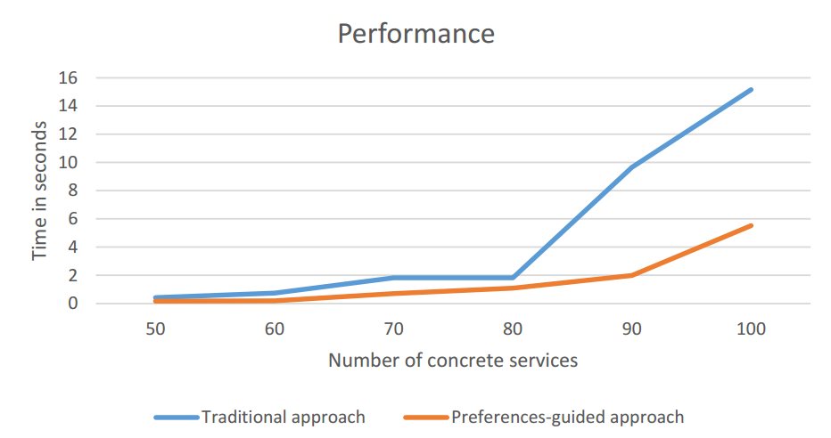
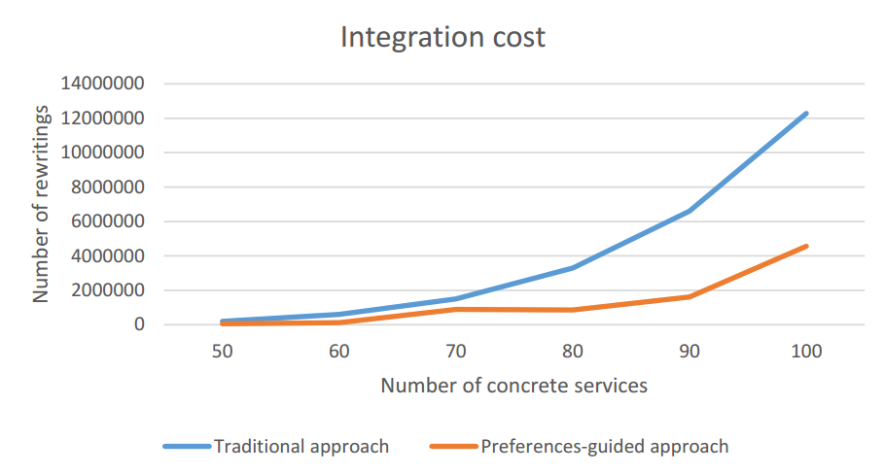
Rhone’s profile
Complexity
Selecting candidate concrete services: O (n²)
Creating candidate service descriptions: O (n³)
Combining CSDs: O (n^{k})^{m}
Producing rewritings: O (n)
Performance increased reducing
The number of rewriting solutions
Integration execution time
Rewriting solutions quality enhanced
Integration economic cost potentially reduced
Notes:
Based on the experimental validation, we can show you the Rhones’ profile
We can see the complexity of the different phases...
As in the other algorithms, the most expensive step is the combination. It depends on the size of the query and the number of concrete service that could be mapped to the query
The results of our experimental validation are illustrated by these two charts.
The performance increased ... As we can see in the chart on the left
Rewritring solutions ...
Integration economic cost ... as we can see in the chart on the right

Slide 24
Thank you for your attention!
Daniel Aguiar da Silva Carvalho,
Magellan, IAE, Univ. J. Moulin Lyon 3, France
Plácido Antonio de Souza Neto, DIATINF, IFRN, Brazil
Chirine Ghedira-Guegan, Magellan, IAE, Univ. J. Moulin Lyon 3, France
Nadia Bennani, LIRIS-CNRS, INSA-Lyon, Univ. Lyon, France
Genoveva Vargas-Solar, CRNS, LIG-LAFMIA, France
Notes:
And that’s the end of my speech. Thank you for your attention.

Slide 25
References
Ba, C., Costa, U., Halfeld-Ferrari, M., Ferre, R., Musicante, M.A., Peralta, V., Robert, S.: Preference-driven refinement of service compositions. In: International Conference on Cloud Computing and Services Science, Proceedings of CLOSER 2014 (2014)
Barhamgi, M., Benslimane, D., Medjahed, B.: A query rewriting approach for web service composition. IEEE Trans. Serv. Comput. 3, 206–222 (2010)
Bennani, N., Ghedira-Guegan, C., Musicante, M., Vargas-Solar, G.: Sla-guided data integration on cloud environments. In: 2014 IEEE 7th International Conference on Cloud Computing (CLOUD), pp. 934–935, June 2014
Benouaret, K., Benslimane, D., Hadjali, A., Barhamgi, M.: FuDoCS: a web service composition system based on fuzzy dominance for preference query answering. In: 37th International Conference on Very Large Data Bases (VLDB 2011)
Carvalho, D.A.S., Neto, P.A.S., Vargas-Solar, G., Bennani, N., Ghedira, C.: Can data integration quality be enhanced on multi-cloud using SLA? In: Chen, Q., Hameurlain, A., Toumani, F., Wagner, R., Decker, H. (eds.) DEXA 2015. LNCS, vol. 9262, pp. 145–152. Springer, Heidelberg (2015)
ElSheikh, G., ElNainay, M.Y., ElShehaby, S., Abougabal, M.S.: SODIM: service oriented data integration based on MapReduce. Alexandria Eng. J. 52, 313–318 (2013)
Halevy, A.Y.: Answering queries using views: a survey. VLDB J. 10(4), 270–294 (2001)
Tian, Y., Song, B., Park, J., Huh, E.-N.: Inter-cloud data integration system considering privacy and cost. In: Pan, J.-S., Chen, S.-M., Nguyen, N.T. (eds.) ICCCI2010, Part I. LNCS, vol. 6421, pp. 195–204. Springer, Heidelberg (2010)
Notes:
Here are the references we have used.
If you have any question I am here to answer it.

